Slide 1
SOFTWARE REQUIREMENTS SPECIFICATION (SRS)
Group No: 3

Slide 2
SOFTWARE REQUIREMENT SPECIFICATION
Definition
SRS is a comprehensive document that describes what a software system will do and how it will be expected to perform.
It serves as a blueprint for the development team and a contract between the stakeholders and the developers.
It clearly defines functional and non-functional requirements, constraints, and system behaviour before development begins.
In simple words:
SRS focuses on “WHAT” the system should do, not “HOW” it will be built.

Slide 3
Requirements vs Specifications
Requirements = What stakeholders need.
Specifications = Exact description of system behaviour.

Slide 4
Purpose of an SRS
1. Establish a Common Understanding Among Stakeholders
The SRS provides a single, agreed-upon reference point for:
Clients
End users
Developers
Testers
Project managers
This prevents misunderstandings caused by verbal or informal requirements.

Slide 5
Continue…
2. Serve as a Contractual Agreement
  Once approved, the SRS acts as a formal contract between the client and the development team.
  Any feature not specified in the SRS is considered out of scope unless formally changed.
3. Provide a Basis for System Design
  The system architecture, database design, and user interface design are all derived from the SRS.
  Design decisions must satisfy the requirements defined in the SRS.

Slide 6
Continue…
4. Guide Software Development (Implementation)
  Developers use the SRS as a technical reference to ensure that:
    All required functionalities are implemented
    No unnecessary features are added
  This improves development efficiency and accuracy.
5. Support Verification and Validation (Testing)
  The SRS provides a baseline for test case creation.
  Each requirement in the SRS should have corresponding test cases.

Slide 7
Continue…
6. Assist in Project Planning and Estimation
  Project managers use the SRS to:
  Estimate cost and time, Allocate resources , Identify risks
  A well-defined SRS improves project scheduling accuracy.
7. Facilitate System Maintenance and Evolution
  After deployment, the SRS helps maintenance teams:
    Understand system functionality
    Implement enhancements
    Fix defects without ambiguity

Slide 8
COMPONENTS OF AN SRS
A standard SRS (often based on the IEEE 830 standard) is generally divided into three main sections:
A. Introduction
  Purpose: Who is this document for?
  Scope: What will the software do (and just as importantly, what will it not do)?
  Definitions/Acronyms: A glossary to ensure everyone understands technical terms.
B. Overall Description
  Product Perspective: Is this a standalone product or part of a larger system?
  User Classes: Who are the different types of users (Admin, Guest, Editor)?
  Operating Environment: Which OS, browsers, or hardware are required?
  Constraints: Regulatory policies, hardware limitations, or budget caps.

Slide 9
Continue…
C. Specific Requirements
This is the "meat" of the document, usually categorized into two types:
  Functional Requirements: These define what the system does.
  Example: "The system shall allow users to reset their password via email."
  Non-Functional Requirements: These define how the system performs (quality attributes).
  Example: "The system must load pages within 2 seconds" (Performance) or "Data must be encrypted using AES-256" (Security).

Slide 10
Characteristics of a Great SRS
Correct
An SRS is correct if every requirement accurately represents the actual needs of
stakeholders.
    Requirements must be validated with users and clients
    No unnecessary or wrong requirements should be included
  Meaning: The system is solving the right problem.
2. Unambiguous
  An SRS is unambiguous when each requirement has only one clear interpretation.
    Avoid vague words such as fast, easy, user-friendly
    Use precise and measurable statements
  Meaning: Different readers understand the requirement in the same way.

Slide 11
Continue…
3. Ranked (Prioritized)
  Requirements should be ranked according to importance and stability.
  Critical requirements are implemented first
  Less important or optional requirements are lower priority
Meaning: Helps in planning, scheduling, and handling limited resources.
4. Verifiable
  A requirement is verifiable if it can be tested or measured.
  There must be a way to confirm that the requirement is satisfied
  Verification can be done through testing, inspection, or analysis
Meaning: You can prove whether the system meets the requirement or not.

Slide 12
Continue…
5. Modifiable
  An SRS is modifiable if changes can be made easily and consistently.
  Meaning: The document can evolve as requirements change.
6. Traceable
  An SRS is traceable when each requirement can be tracked:
  Backward → to its source (user need or business goal)
  Forward → to design, code, and test cases
Meaning: You know where a requirement came from and where it is implemented.

Slide 13
Continue…
7. Complete
An SRS is complete if it includes all necessary requirements.
    All functional requirements
    All non-functional requirements
    All interfaces, constraints, and assumptions
8. Consistent
An SRS is consistent when there are no conflicting requirements.
    Same terms are used throughout the document
    No logical contradictions between requirements
Meaning: Requirements do not oppose each other.

Slide 14
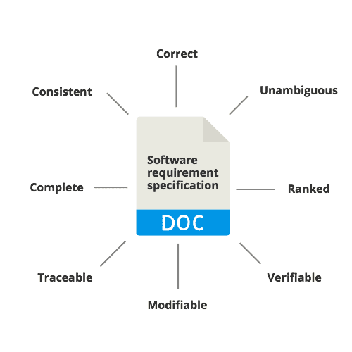

Slide 15
What Techniques Do You Apply to Create an SRS Document?
Brainstorming – Generates many possible ideas and solutions by encouraging free and creative thinking without criticism.
Document Analysis – Identifies requirements by reviewing existing documents such as business plans, contracts, data models, and process flows.
Interface Analysis – Examines user, software, and hardware interfaces to define system boundaries and identify required features.
Interview – Gathers requirements through direct communication with stakeholders or subject matter experts using prepared or spontaneous questions.

Slide 16
Continue…
Prototyping – Builds a preliminary version of the system to validate ideas and clarify requirements.
Mind Mapping – Visually organizes ideas and system components in a hierarchical structure to show relationships.
Focus Group – Uses group discussions with representative users to collect feedback on features, needs, and expectations.
Requirements Workshop – Brings stakeholders together to quickly define and agree on cross-functional requirements.

Slide 17
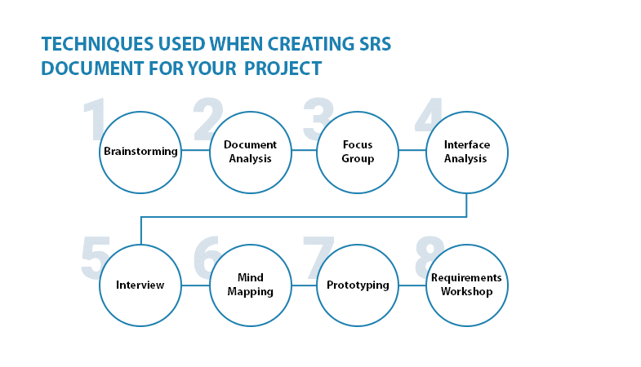

Slide 18
The End
Thank you for your time and attention.

